Slide 1

PRINCIPLES OF LEADERSHIP COURAGE AND MORAL LEADERSHIP
SPRING 2023
CHAPTER 06
FAREED QURESHI

Slide 2
CHAPTER OBJECTIVES
Combine
Combine a rational approach to leadership with a concern for people and ethics.
Recognize
Recognize your own stage of moral development and ways to accelerate your moral maturation.
Apply
Apply the principles of stewardship and servant leadership.
Know and use
Know and use mechanisms that enhance an ethical organizational culture.
Recognize
Recognize courage in others and unlock your own potential to live and act courageously.

Slide 3
Unethical Versus Ethical Leadership
The Unethical Leader
Is arrogant and self-serving
Excessively promotes self-interest
Practices deception
Breaches agreements
Deals unfairly
Shifts blame to others
Diminishes others’ dignity
Neglects follower development
Withholds help and support
Lacks courage to confront unjust acts
The Ethical Leader
Possesses humility
Maintains concern for the greater good
Is honest and straightforward
Fulfills commitments
Strives for fairness
Takes responsibility
Shows respect for everyone
Encourages and develops others
Serves others
Shows courage to stand up for what is right

Slide 4
How to Act Like a Moral Leader
Develop, articulate, and uphold high moral principles.
Focus on what is right for the organization as well as all the people involved.
Set the example you want others to live by.
Be honest with yourself and others.
Drive out fear and eliminate undiscussables.
Establish and communicate ethics policies.
Develop a backbone – show zero tolerance for ethical violations.
Reward ethical conduct.
Treat everyone with fairness, dignity, and respect, from the lowest to the highest level of the organization.
Do the right thing in both your private and professional life – even when no one is looking.

Slide 5

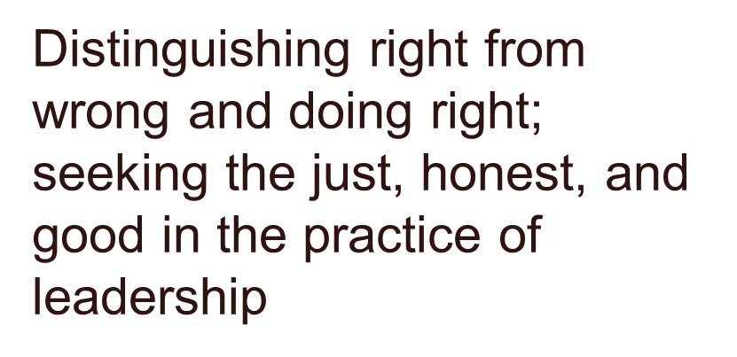
MORAL LEADERSHIP

Slide 6
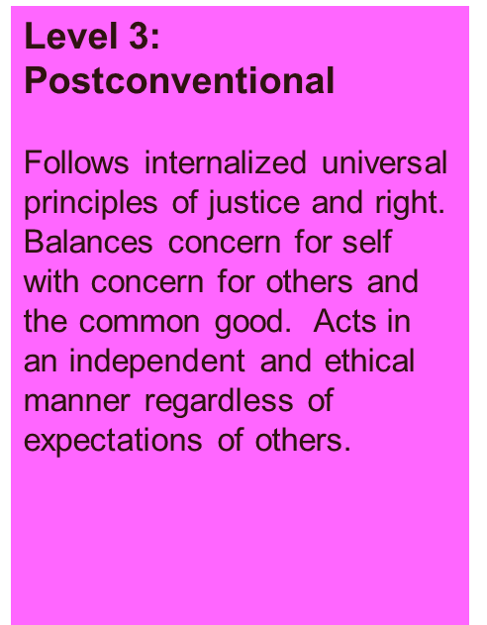
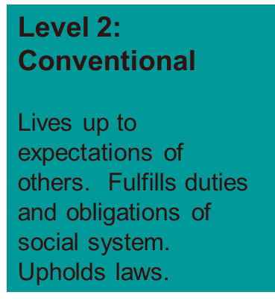
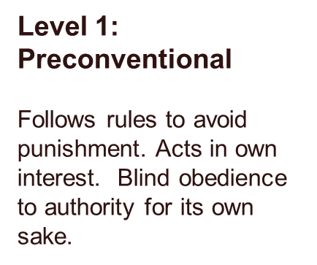

THREE LEVELS OF PERSONAL MORAL DEVELOPMENT

Slide 7
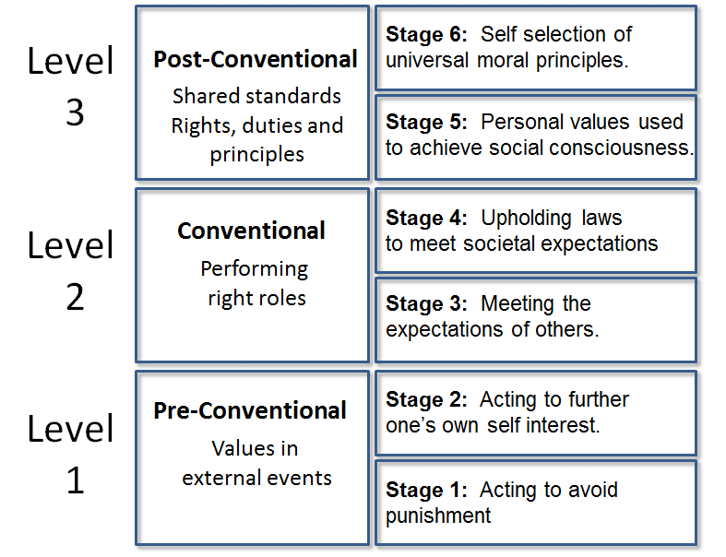

Slide 8
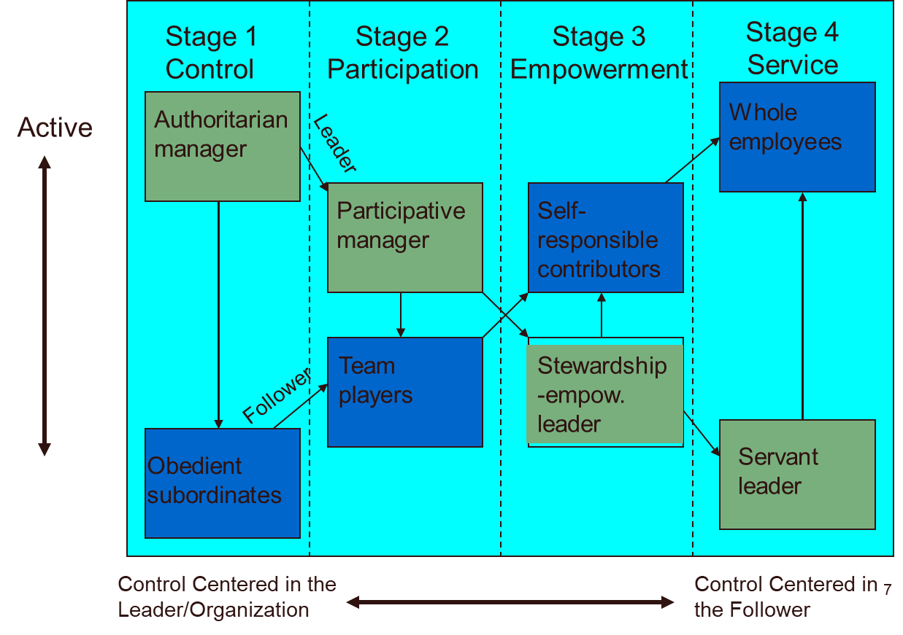

Continuum of Leader-Follower Relationships

Slide 9
COURAGE
To laugh … is to risk appearing the fool.
To weep … is to risk appearing sentimental.
To reach out … is to risk involvement.
To expose feelings … is to risk exposing your true self.
To place your ideas and dreams before a crowd … is to risk rejection.
To love … is to risk not being loved in return.
To live … is to risk dying.
To hope … is to risk despair.
To try … is to risk failure.
But risks must be taken, because the greatest hazard in life is to risk nothing. Those who risk nothing do nothing and have nothing.
They may avoid suffering and sorrow, but they cannot learn, feel, change, grow, or love.
Chained by their certitude, they are slaves; they have forfeited their freedom.
Only one who risks is free
The mental and moral strength to engage in, persevere through, and withstand danger, difficulty, or fear
Accepting responsibility
Nonconformity
Pushing beyond the comfort zone
Asking for what you want and saying what you think
Opposing the unethical conduct – whistleblowing

Slide 10

THAT IS ALL FOR TODAY !!

